Slide 1
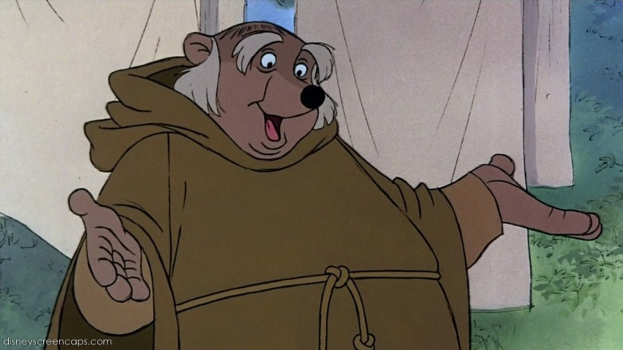
Medieval Medicine and Healers
Identify who people went to for help in medieval times.
Compare different healers in this era
Analyse why doctors were rare.

Slide 2
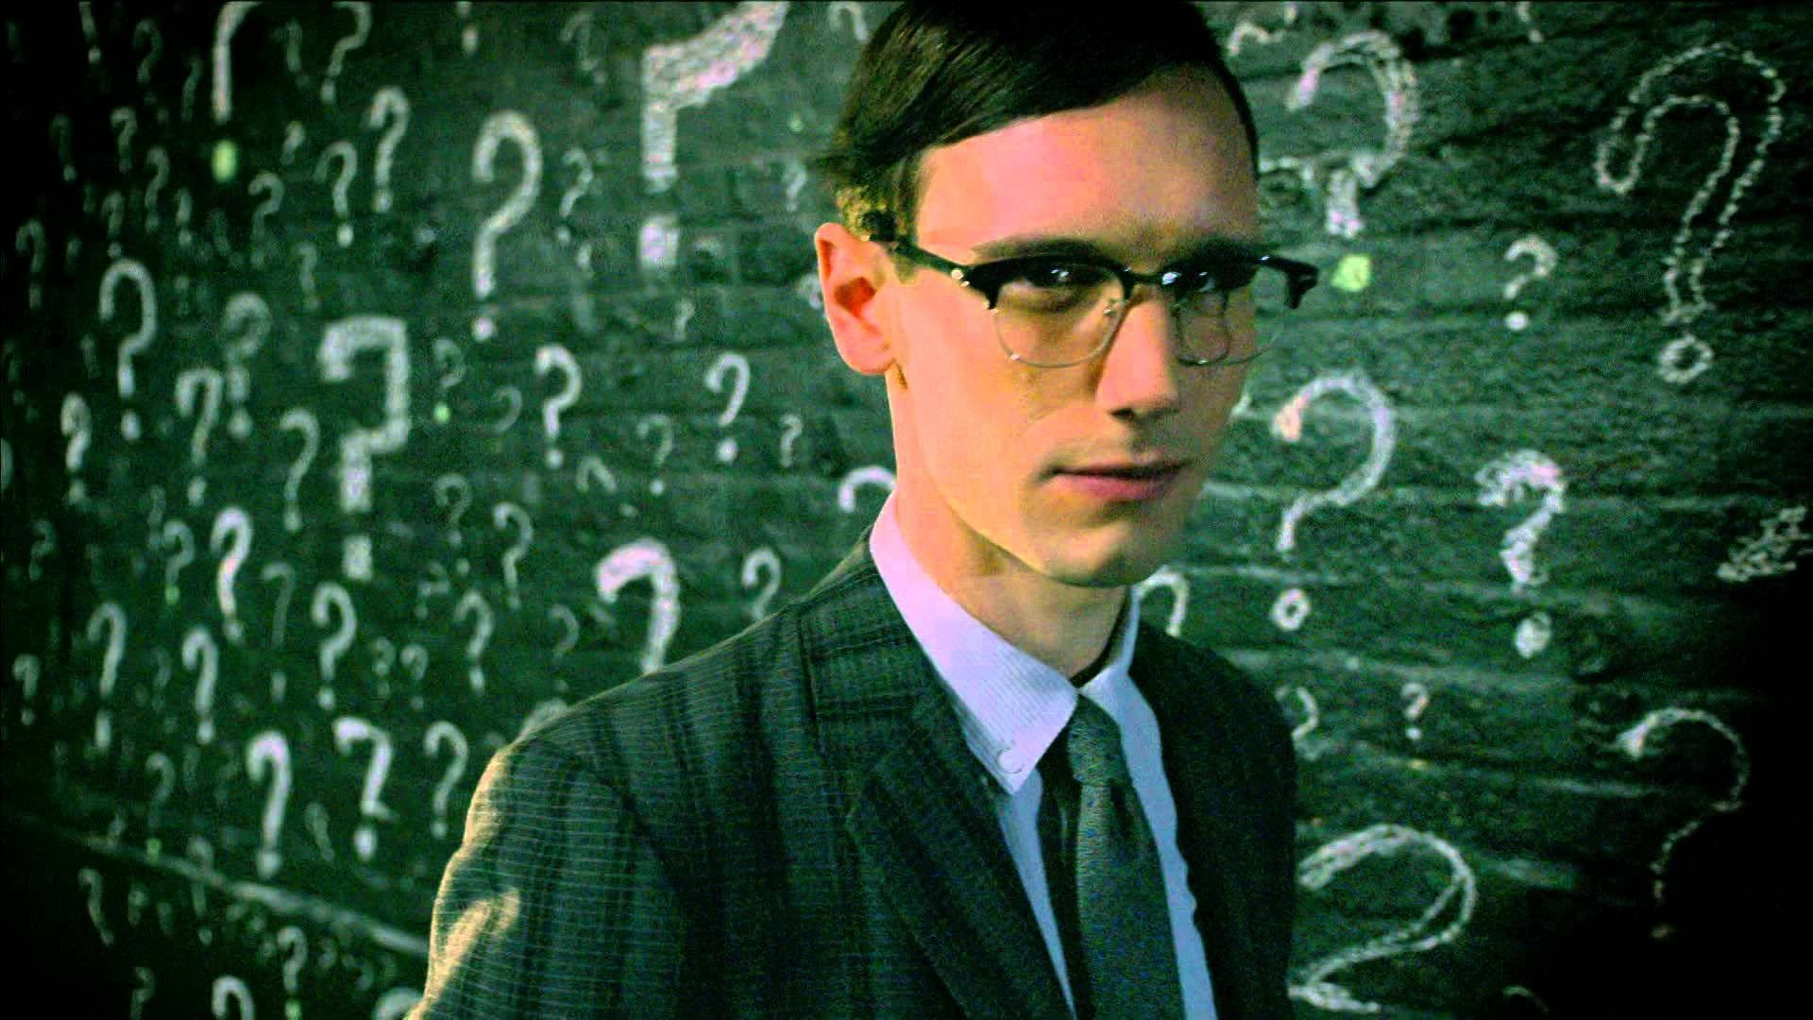
Starter
Try and identify the people who provided medical aid in the medieval era using the Riddler’s clues.

Slide 3
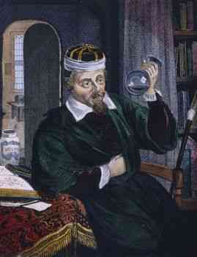

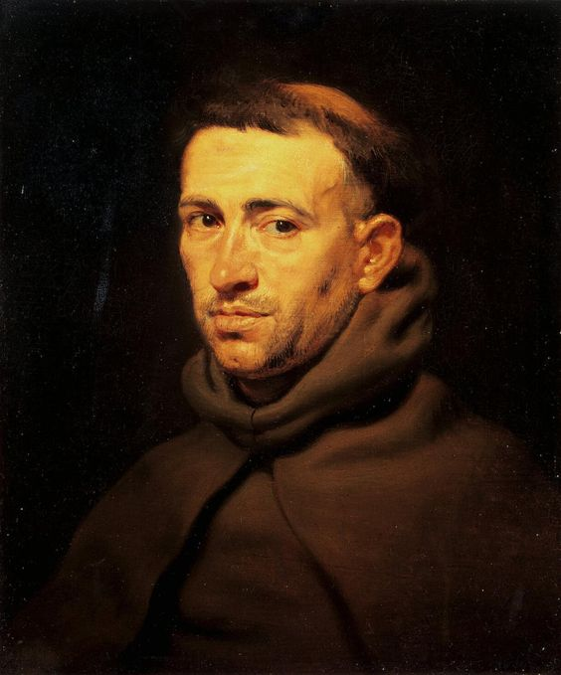
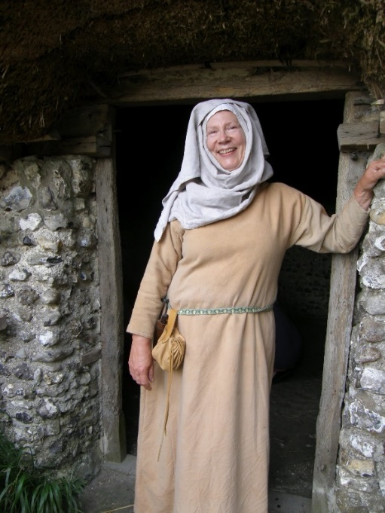
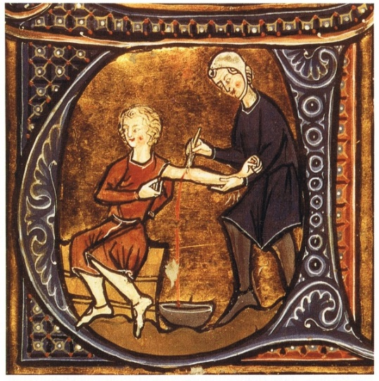
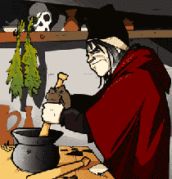
Male, well educated at university, seeks rich customers for treatment and aid.
Single, male, lives in communal building. Able to offer prayers, bed rest and bible readings.
Mature female, uneducated, background in cooking, herbs, local remedies and treatments
Male, not scared of blood. Able to follow a doctors orders to cut you up.
Creative male, good at mixing chemicals and herbs. Expert in making medicines

Slide 4
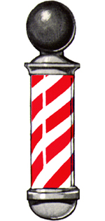
Medical Care
Doctors were rare and expensive therefore most people could not afford to see when one they were ill.
If you lived in a town you could go to the pharmacy (chemist) and buy medicines.
You could also go to a Barber Surgeon. These were men who did simple operations such as remove in-growing toenails or deal with kidney stones. They also performed operations for the doctors.

Slide 5
Medical Care for the poor
The poor could not afford to pay for a doctor.
Many were looked after by local wise women. Women who knew about herbs that helped pain, and especially how to deliver babies.
The other source of medical care was the local monastery. People would be given a bed, food and were warm so they could recover. They did not have medicines though, instead they prayed for you.

Slide 6

Activity
Now return to your starter.
Add details about each type of healer:
Job:
Type of Patients:
Main treatments offered:
Add some quick cartoons

Slide 7
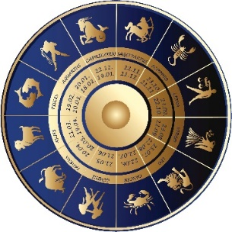
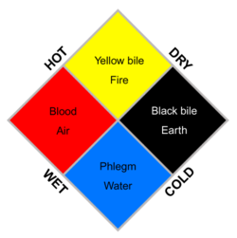

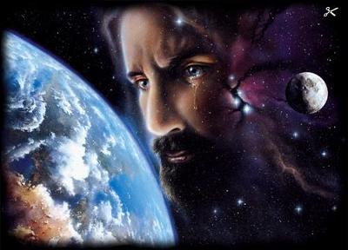
What causes illness/disease?
The Four Humours.
Opposites/Balance and appropriate action
The stars and astrology formed a part of medical care.
Miasma:
Bad smelling air makes you sick.
People believed that most diseases were caused by bad air. Germs had not been discovered yet.
God has brought it upon you

Slide 8
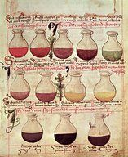
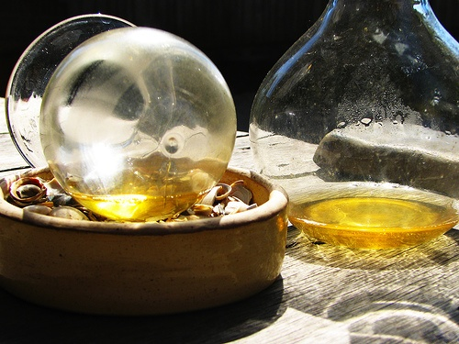
Checking the symptoms
Doctors would consult star charts and a book called a Vade Mecum. This was a little medical book that they carried around
Another common way of testing you was to get a sample of your urine. They would compare the colour (four humours) and even smell and/or taste it!

Slide 9
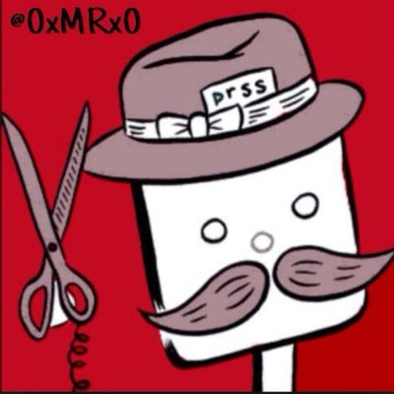
Activity
Cut out and sort the cards.
Two per category.
Now answer the following questions:
Why did very few people see doctors?
What did people believe made you sick in medieval times?
Which do you think was the most effective healer?

Slide 10
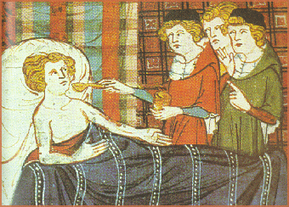
Supernatural
Purging
Pilgrimages
Charms
Prayers
Emetics (make you vomit)
Enemas (Spray up the rectum)
Laxatives (make you poo)
How did medieval people aim to cure illness and disease?
Astrology
The Four Humours
Alignment of planets determined how and when to treat
Informed almost all decisions about how to treat the sick – e.g. ensure balance of humours
Remedies
Blood-letting
Use of herbal remedies, e.g. aloe vera, Theriaca (various drugs with honey)
Using cuts or leeches to get unneeded blood out to rebalance you.

Slide 11
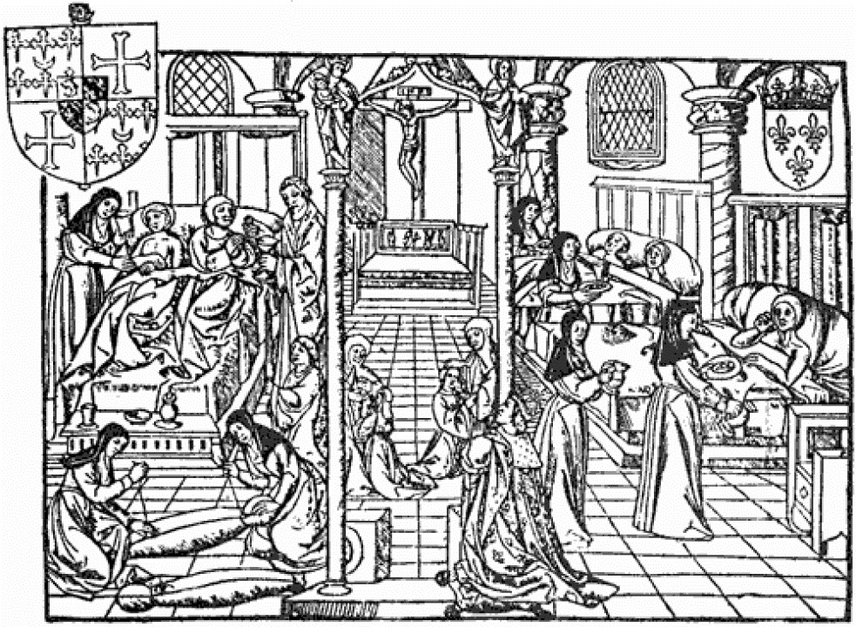
Starter
EXTRA CONTENT
How useful is this source to a historian who is investigating Medieval Hospitals? (8 marks)

Slide 12
Medieval Medicine and Healers
Identify who people went to for help in medieval times.
Compare different healers in this era
Analyse why doctors were rare.

Slide 13

Name the treatment game
How should we treat each problem and who would we go to for the treatment?

Slide 14
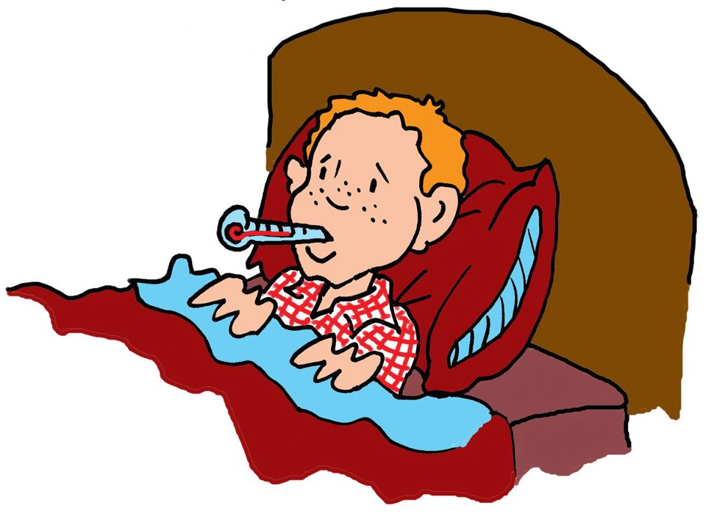
HELP!
A high temperature: He needs a to get him bled and given something cool like cucumber to balance his humours
Doctor/ Physician

Slide 15
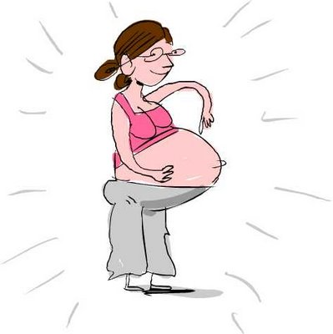
HELP!
Child birth: This lady needs the local ________ to assist her giving birth at home.
Wise Woman

Slide 16
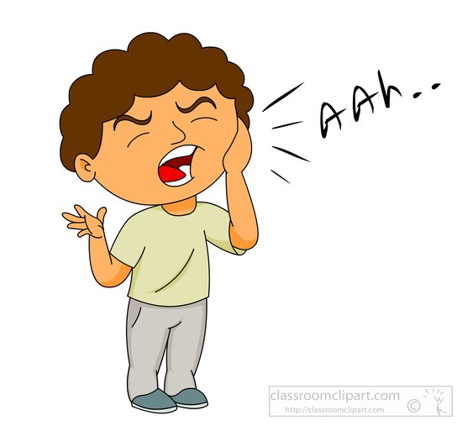
HELP!
Tooth ache: He needs a _____ remove the tooth
Barber Surgeon

Slide 17
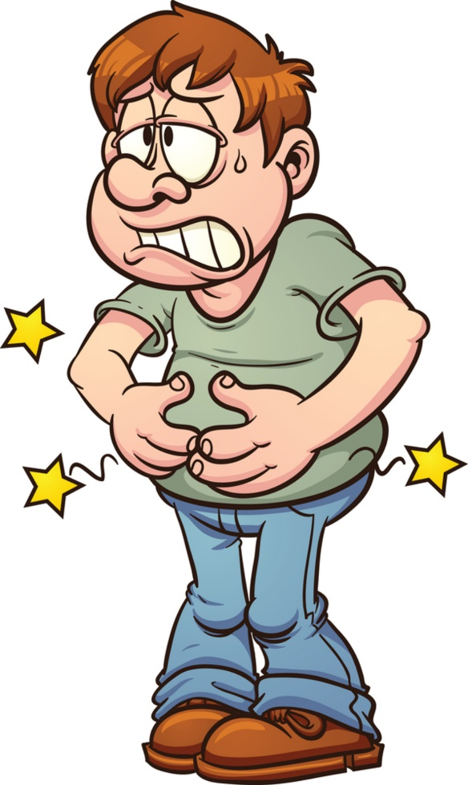
HELP!
Upset Stomach: I have a belly ache. A _____ can give me something to purge my system
Chemist

Slide 18
HELP!
A high temperature: He needs a doctor to get him bled and given something cool like cucumber to balance his humours
Doctor/ Physician

Slide 19
A simple life

